Slide 20
“We think sometimes that poverty is only being hungry, naked, and homeless. The poverty of being unwanted, unloved, and uncared for is the greatest poverty. I have come more and more to realize that it is being unwanted that is the worst disease that any human being can ever experience. We must start in our own homes to remedy this kind of poverty.”
Mother Teresa (1910-1998)

Slide 21
Homelessness and Poverty

Slide 22
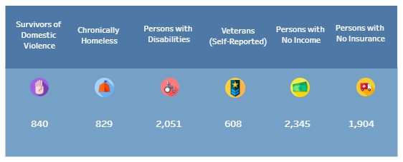
CENTRAL FLORIDA
5,180 residents of Orange, Osceola, and Seminole county meet this “literal” or HUD’s (Housing and Urban Development) definition of homelessness.
This DOES not count
those living in hotels.

Slide 23
How do we define homelessness in education?

Slide 25
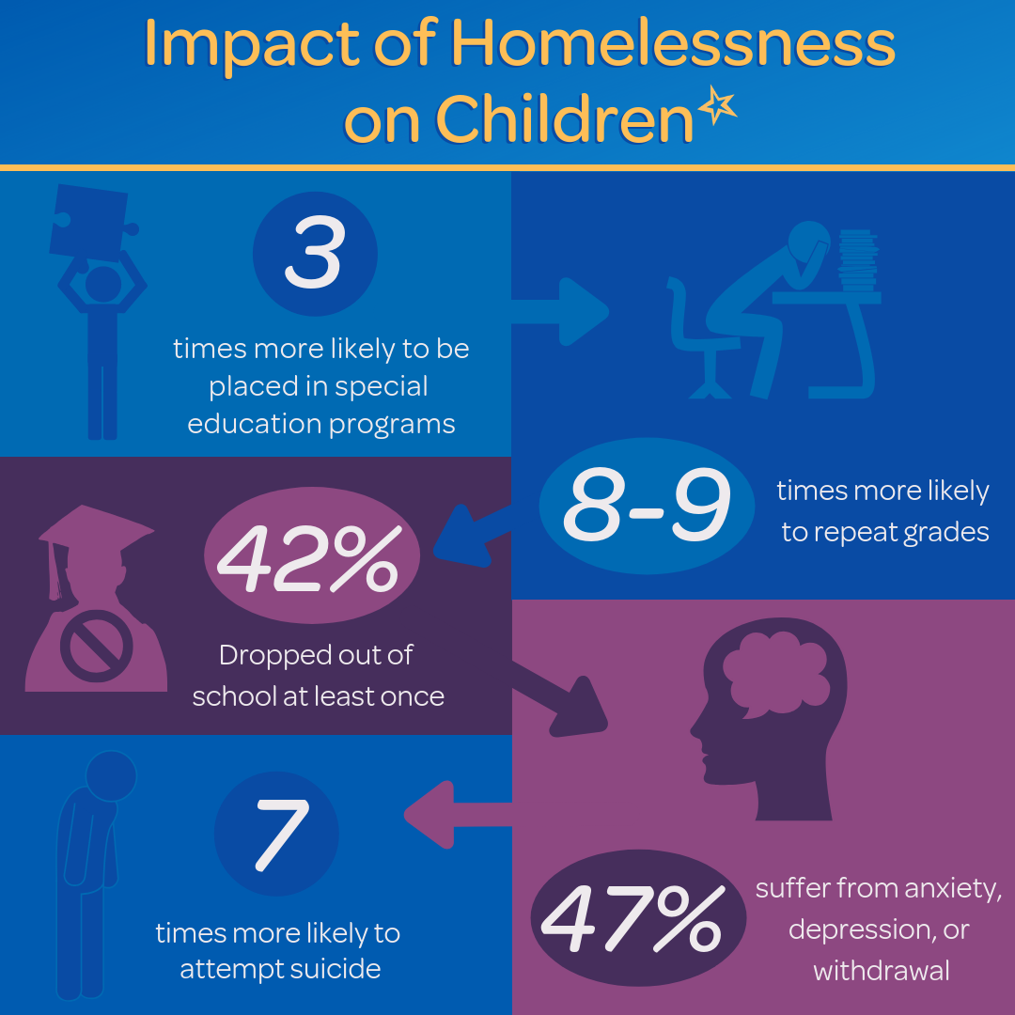

Slide 26
McKinney-Vento Act
1987- Signed into law
1990 - Elimination of enrollment barriers is added
1994 – Pre-school services is added
2002 – All districts required to have a local liaison
2015 – Act reauthorized under ESSA and feeder patterns added to school of origin rights

Slide 27
Notes:
Stability is the main purpose of the McKinney-Vento Law, this is the whole reason why the law was created. Since we know the definition of homeless in education is, not your typical image, we want to remove that misconception from our minds. In reality, our families working minimum wage jobs most likely qualify for MVP services. These are the students that need the stability the most.
In order to help these students, stability is needed. Students are moving around from place to place, which makes learning difficult. Education and breaking the generational cycle of homelessness is where our work comes in. We have to ensure that students receive additional supports to succeed in school.

Slide 29
WHO WE SERVE

Slide 30
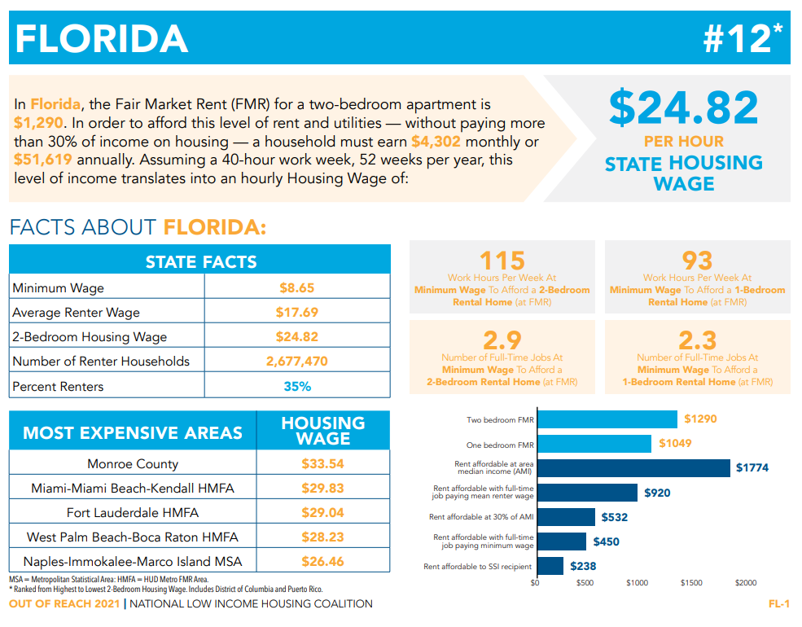
Notes:
Discuss with participants that currently minimum wage does not meet the cost needed to rent a two bedroom home. A single parent working minimum wage will more than likely qualify under MVP.
In Florida, Minimum Wage is a topic of discussion in November’s Election; the reality is that the full effect will take place in 2026.
Could rent costs increase by 2026? Could the cost of living go up?
The sad reality is that our families that cannot afford rent and/or earn minimum wage may be eligible for MVP.

Slide 31
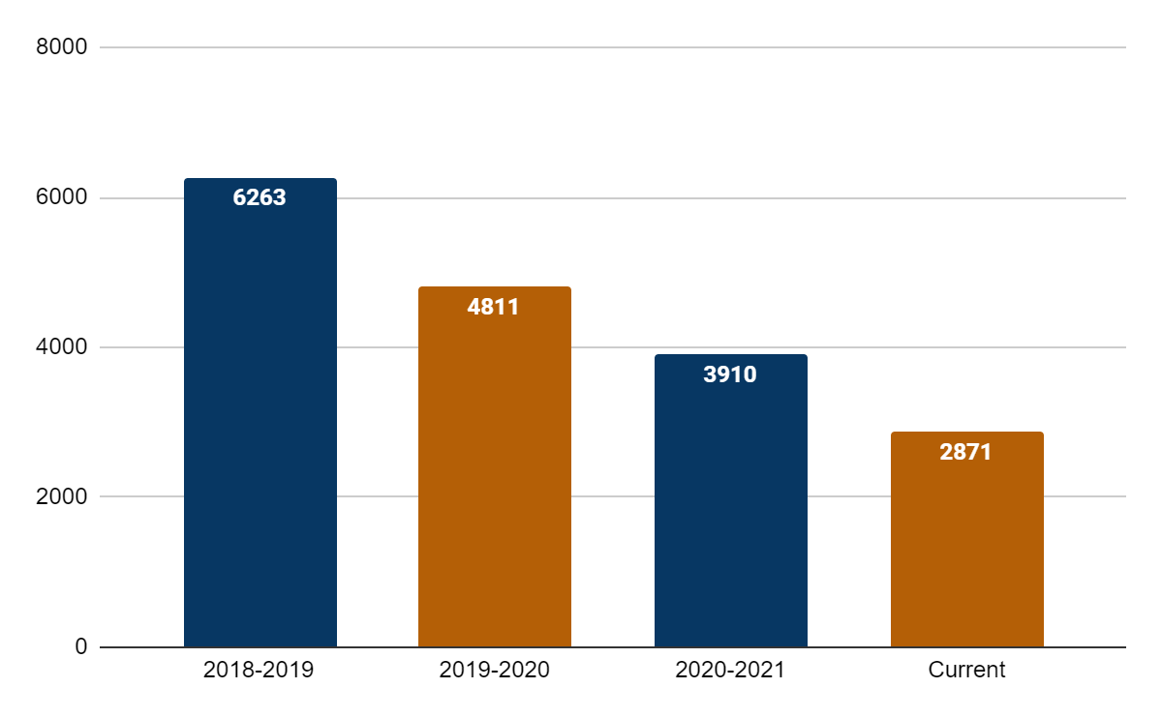
ORANGE COUNTY PUBLIC SCHOOLS

Slide 32
Notes:
Play Video

Slide 33
HOW DO WE ASSIST?
INCREASED STAFF TRAININGS from 8 in 2019-2020 to 74 in 2020-2021
ORGANIZED CENTRAL FLORIDA HOMELESS EDUCATION SUMMIT - 21 agencies and over 150 school staff in attendance from three counties.

Slide 34
HOW DO WE ASSIST?
DEPARTMENT COLLABORATION:
Federal Programs
Student Services
Multilingual
Guidance
Curriculum
Minority Achievement Office
Media Relations
Food and Nutrition Services
Emergency Management
Foundation (501c3)
Transportation
Student Enrollment

Slide 35
HOW DO WE ASSIST?
COMMUNITY COLLABORATION
Continuum of Care
Shelter Sites
Church Missions
Second Harvest
Family Promise
Safe Families
Colleges
Grocery Stores
Restaurants
Clothing Stores
Government Agencies

Slide 36
ACTIONS and SHIFTS
Junior and Senior Calls
Utilize Social Workers to call and support with graduation plans.
Extended to include guidance team.
Added in a College Guide
DID YOU KNOW?
FREE TUITION FOR MVP!

Slide 37
ACTIONS and SHIFTS
Kids’ Closet
Clothing, School Supplies, Hygiene Items
Pick-up by any school staff member
Coordinating a new project with Student Services
Adjust for special situations
TIP!
BECOME FRIENDS WITH THE COMMUNITY PARTNERS COORDINATOR

Slide 38
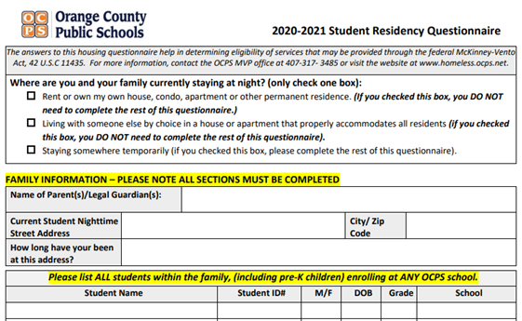
ACTIONS and SHIFTS
Student Residency Questionnaire
Went digital!
Allow staff to complete on behalf of family (law requires us to identify)
Email Communication
helphomeless@ocps.net

Slide 39
GIVING CAMPAIGNS
tinyurl.com/ocpsholidaygifts

Slide 40
McKinney-Vento Act Rights
School Stability
Zoned school and School of Origin
Transportation
Over 2 miles.
School Enrollment
No deadline to receive forms.
Immediate enrollment includes digital learning (priority in device distribution).
Immediate includes transportation (call our office for support) – bus passes or gas cards while bus is being routed.
Free Meals
Starts on day one, can provide Student Residency Questionnaire to cafeteria manager
Automatically in system for free lunch the day after coded in Skyward

Slide 41
QUESTIONS
Christine Cleveland
christine.cleveland@ocps.net
helphomeless@ocps.net

